Slide 1


Slide 2

مدیریت استراتژیک فناوری اطلاعات نقش استراتژیک سیستم های اطلاعاتی
تهیه و تنظیم:
رضا میرزاباقری

Slide 3
Learning Objectives
Identify basic competitive strategies and explain how a business can use IT to deal with the competitive forces it faces
Identify several strategic uses of IT and give examples of how they give competitive advantages to a business

Slide 4
Learning Objectives
Identify the business value of using Internet technologies to become an agile competitor or to form a virtual company
Explain how knowledge management systems can help a business gain strategic advantages

Slide 5
Business strategy
‘The direction and scope of an organization over the long-term: which achieves advantage for the organization through its configuration of resources within a changing environment to meet the needs of markets and to fulfil stakeholder expectations’.
Johnson and Scholes (1999)

Slide 6
Business strategy
“Definition of the future direction and actions of a company defined as approaches to achieving objectives”
Bocij, Chaffey, Greasley & Hickie (2006)

Slide 7
Strategy approaches
Prescriptive: (تجویزی)
Planned analytical approach
Conscious and analytical thought
Top-down and control orientation
Simple and structured
Emergent: (نوپدید)
Responsive to changes to market and business needs.
To be successful, the strategic plan needs to be modified to reflect new situation.

Slide 8
Elements of IS strategy
Business information strategy: This defines how information, knowledge and the range of business applications (the applications portfolio( will be used to support business objectives.
IS functionality strategy: This defines, in more detail, the requirements for services delivered by the range of business applications (the applications portfolio).
IT strategy (IS/IT strategy): This defines the software and hardware standards and suppliers which make up IT infrastructure.

Slide 9
IT versus IS strategy
IS strategy: Determination of the most appropriate processes and resources to ensure that information supports business strategy.
IT strategy: Determination of the most appropriate technological infrastructure comprising hardware, networks and software applications.

Slide 10
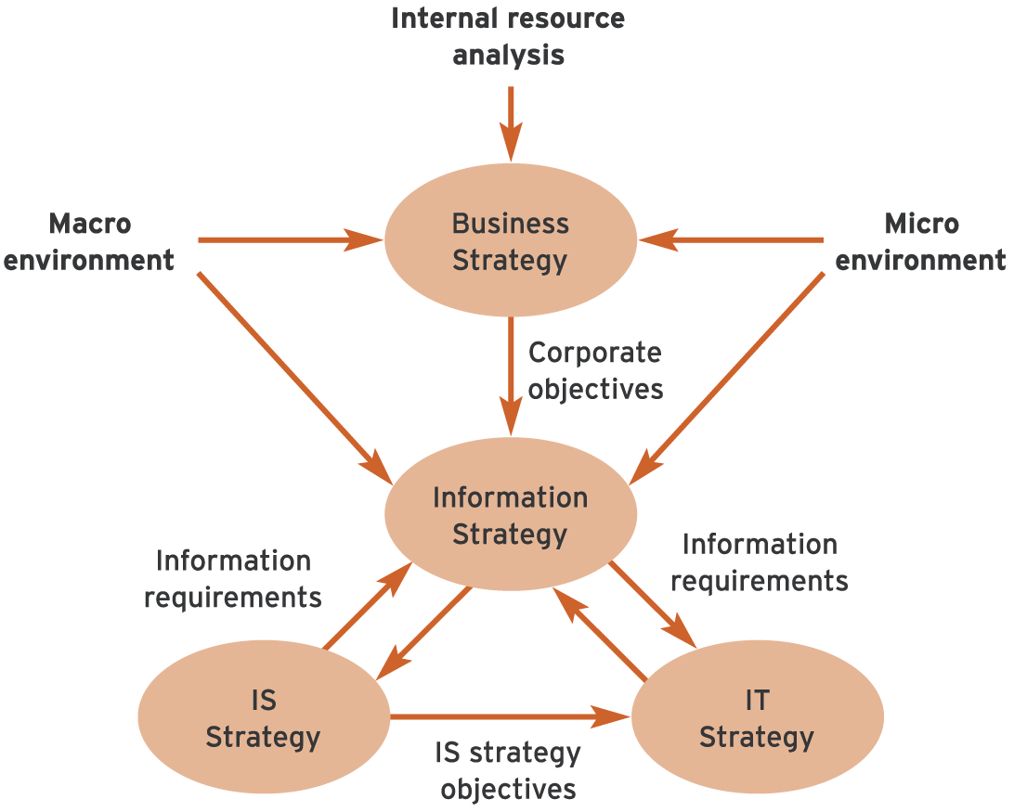
Relationship between business strategy and IS/IT strategies
Business information strategy driven by the objectives of the business strategy.
IT strategy – implementation of IS strategy through the delivery of IT infrastructure
.

Slide 11
Strategic IT
Technology is no longer an afterthought in business strategy, but the cause and driver
IT can change the way businesses compete
A strategic information system is any information system that uses IT to help an organization…
Gain a competitive advantage
Reduce a competitive disadvantage
Or meet other strategic enterprise objectives

Slide 12
Environment
Micro-environment: Immediate environment includes customers, competitors, suppliers and distributors.
Macro-environment: Wider environment of social, legal, economic, political and technological influences.
For IS/IT strategy, the most important environmental influences are those of the immediate market place
the needs of customers and how services are provided to them through competitors and intermediaries and suppliers.

Slide 13
The environment and the modern management essentials
(Lickert, 1997) – highlights how an organisation must compete by using IS strategy to respond to its external environment.
Reach – global competition; Organisations need information and the tools to process it to allow quick, accurate response, any time and anywhere.
Reaction – customers more demanding;
Organisations need IS/IT to access and interpret customer feedback;

Slide 14
The environment and the modern management imperatives
Responsiveness – shorter time to turn idea into product or service.
Organisations need IS/IT to help manage this process.
Refinement – customers more able to distinguish fine differences between products and compare them with their needs and desires. Increase size of information is required to create and market products.
Reconfiguration – changing customer needs led to re-engineer work patterns and organisational structures, workflow from idea to product

Slide 15
The environment and the modern management imperatives
Redeployment – changing an organisation's configuration may require reorganisation and redesign of the financial, physical, human and information resources that are required to create and market a product or service.
Information need to be maintained relevant at all times.
Reputation – organisations need to enhance the quality and reliability of the products.
IS can be used to support areas such as quality benchmarks measurement and group-based control techniques.

Slide 16
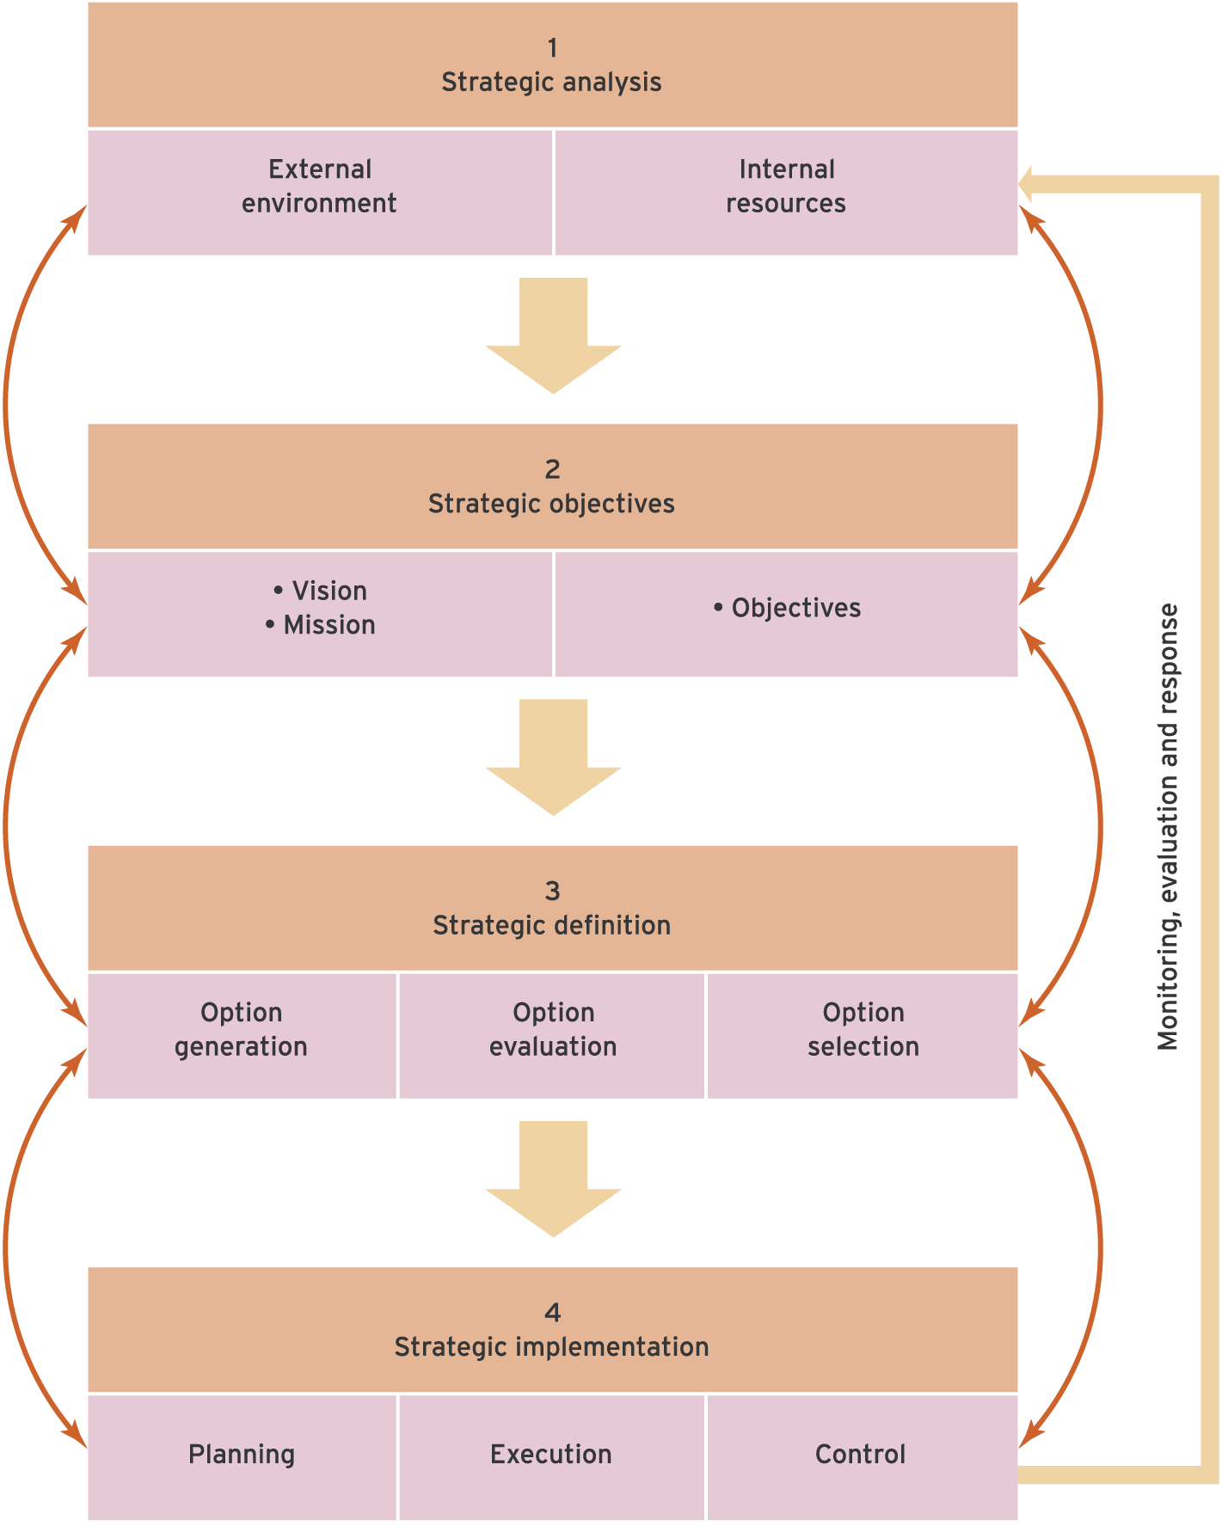
A strategy process model provides a framework that gives a logical sequence to follow to ensure inclusion of all key activities of strategy development.
Continuous internal and external environment scanning and analysis is required to assess internal strength and weaknesses and external opportunities and threats
Clear statement of objectives is needed and a vision of the future direction of the organisation is required.
Strategy development can be broken down into formulation of different strategic options and then selection.
After strategy development, enactment of the strategy occurs as strategy implementation.
Control is required to detect problems and adjusts the strategy accordingly.
A generic strategy process model
Source: Chaffey (2004).

Slide 17
Tools for strategic analysis
Porter and Millar’s five competitive forces model
Porter’s competitive strategies
Porter’s Value chain analysis
Nolan’s stage model
McFarlan’s strategic grid
Critical success (CSFs) analysis

Slide 18
Competitive Forces (نیروهای رقابتی)
To succeed, a business must develop strategies to counter these forces:
Competition of competitors within its industry
New entrants into an industry and its markets
Substitute products that may capture market share
Bargaining power of customers
Bargaining power of suppliers

Slide 19
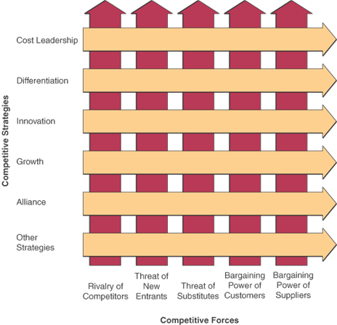
Competitive Forces and Strategies

Slide 20
Five Competitive Strategies
Cost Leadership (Lower Costs)
Become low-cost producers
Help suppliers or customers reduce costs
Increase cost to competitors
eg. Automated hotel front desk system
By using automated front desk system, this hotel doesn’t need to hire human to do the tasks.

Slide 21


Slide 22
Competitive Strategies (continued)
Differentiation Strategy
Differentiate a firm’s products from its competitors’
eg. Capsule hotel in Japan.
This capsule hotel shows a different type of hotel. Here, they don’t need the same space as ordinary hotel to create the same number of rooms as the ordinary hotel. And it needs IT to run the system.

Slide 23
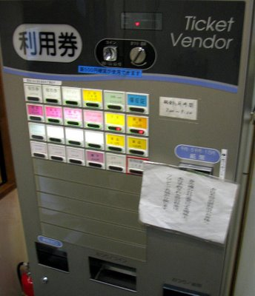
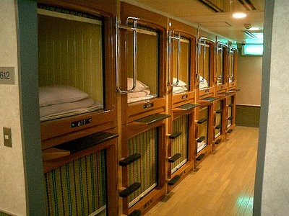



Slide 24
Competitive Strategies (continued)
Innovation Strategy
Unique products, services, or markets
fundamental changes to business processes
eg. Automated parking system
This automated parking system is a very useful system found to ease the lack of parking space due to smaller building space and increased parking capacity.

Slide 25
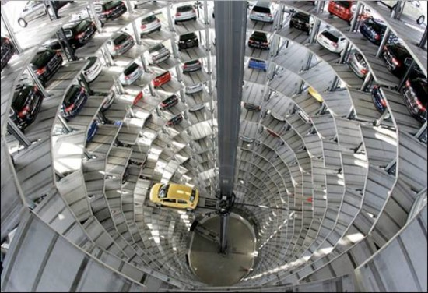

Slide 26
Competitive Strategies (continued)
Growth Strategy
Expand company’s capacity to produce
Expand into global markets
Diversify into new products or services
eg. dhl. Com
We can track / monitor our shipment online.

Slide 27
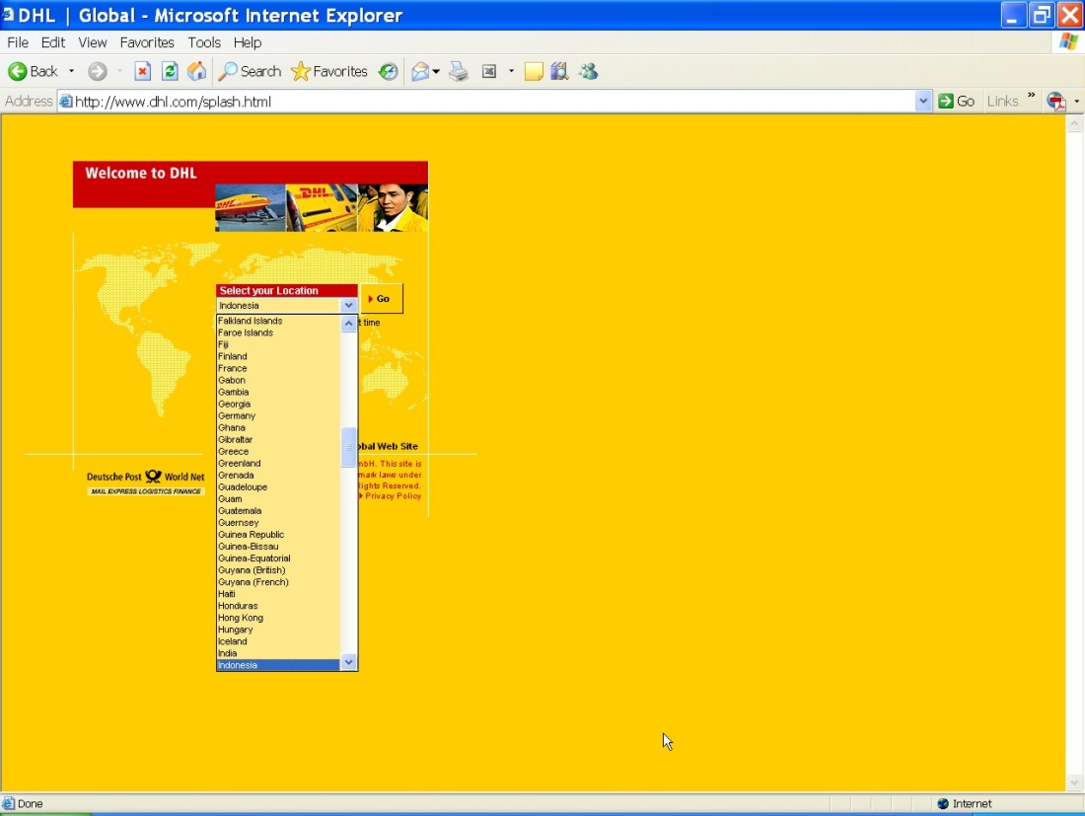
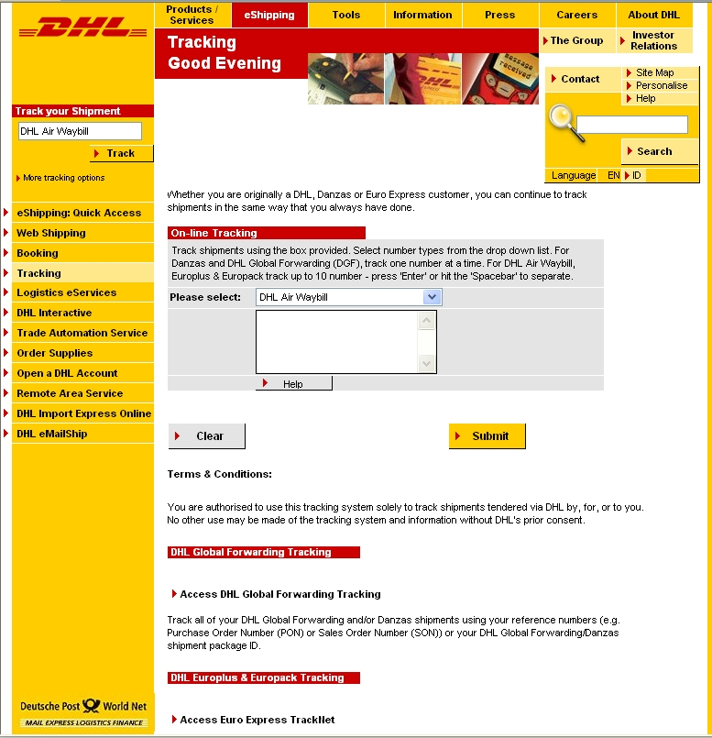

Slide 28
Competitive Strategies (continued)
Alliance Strategy (استراتژی ائتلاف)
Establish linkages and alliances with customers, suppliers, competitors, consultants, and other companies
Example: Facebook

Slide 29
Using Competitive Strategies
These strategies are not mutually exclusive
Organizations use one, some, or all
A given activity could fall into one or more categories of competitive strategy
Not everything innovative serves to differentiate one organization from another
Likewise, not everything that differentiates organizations is necessarily innovative

Slide 30
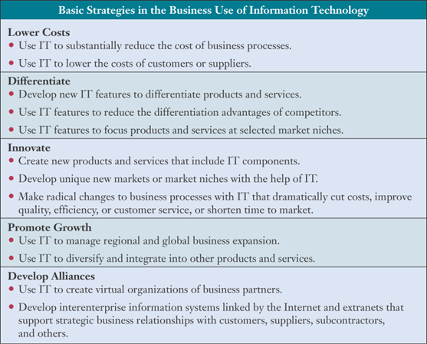

Slide 31
Other Competitive Strategies
Lock in Customers and Suppliers
Deter them from switching to competitors
Build in Switching Costs
Make customers and suppliers dependent on the use of innovative IS
Raise Barriers to Entry
Discourage or delay other companies from entering the market
Increase the technology or investment needed to enter

Slide 32
Other Competitive Strategies
Build Strategic IT Capabilities
Take advantage of strategic opportunities when they arise
Improve efficiency of business practices
Leverage Investment in IT
Develop products and service that would not be possible without a strong IT capability

Slide 33
Customer-Focused Business
What is the business value in being customer-focused?
Keep customers loyal
Predict their future needs
Respond to customer concerns
Provide top-quality customer service
Focus on customer value
Quality, not price, has become the primary determinant of value

Slide 34
Providing Customer Value
Companies that always offer the best value from the customer’s perspective…
Track individual preferences
Keep up with market trends
Supply products, services, and information anytime, anywhere
Tailor customer services to the individual
Use Customer Relationship Management (CRM) systems to focus on the customer

Slide 35
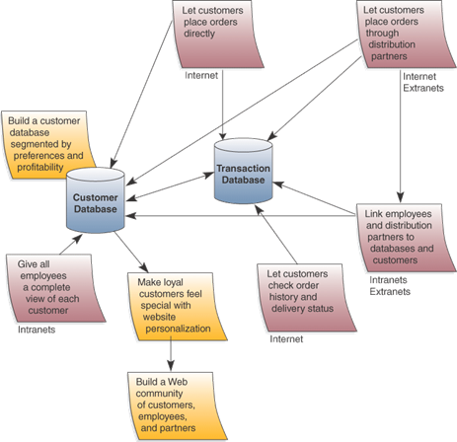
Building Customer Value via the Internet

Slide 36
The Value Chain and Strategic IS
View the firm as a chain of basic activities that add value to its products and services
Primary processes directly relate to manufacturing or delivering products
Support processes help support the day-to-day running of the firm and indirectly contribute to products or services
Use the value chain to highlight where competitive strategies will add the most value

Slide 37
Value Chain
The goal of these activities is to offer the customer a level of value that exceeds the cost of the activities, thereby resulting in a profit margin.
The primary value chain activities are:
Inbound Logistics: the receiving and warehousing of raw materials, and their distribution to manufacturing as they are required.
Production: the processes of transforming inputs into finished products and services.
Outbound Logistics: the warehousing and distribution of finished goods.
Marketing & Sales: the identification of customer needs and the generation of sales.
Service: the support of customers after the products and services are sold to them.

Slide 38
Value Chain
These primary activities are supported by:
The infrastructure of the firm: organizational structure, control systems, company culture, etc.
Human resource management: employee recruiting, hiring, training, development, and compensation.
Technology development: technologies to support value-creating activities.
Procurement: purchasing inputs at the best possible total cost of ownership
such as materials, supplies, and equipment.

Slide 39
Becoming an Agile Company (چابک)
Agility is the ability to success:
By rapidly changing, continually fragmenting global markets
By selling high-quality, high-performance, customer-configured products and services
By using Internet technologies
An agile company profits by:
Broad product ranges
Short model lifetimes
Individualized products

Slide 40
Strategies for Agility
An agile company…
Presents products as solutions to customers’ problems
Cooperates with customers, suppliers and competitors
Brings products to market as quickly and cost-effectively as possible
Organizes to succeed on change and uncertainty
Leverages the impact of its people and the knowledge they possess

Slide 41
Creating a Virtual Company
A virtual company uses IT to link…
People
Organizations
Assets
Ideas
Inter-enterprise information systems link…
Customers
Suppliers
Subcontractors
Competitors

Slide 42
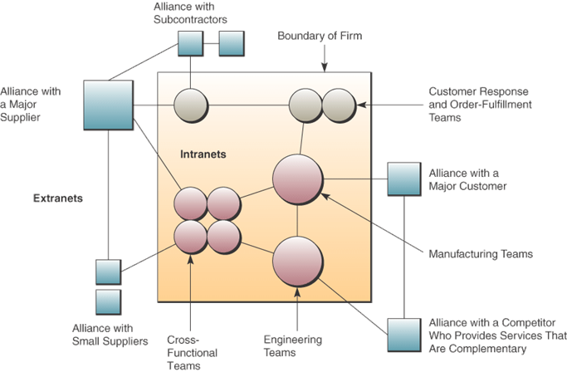
A Virtual Company

Slide 43
Virtual Company Strategies
Basic business strategies
Share information and risk with alliance partners
Reduce concept-to-cash time through sharing
Increase facilities and market coverage
Gain access to new markets and share market or customer loyalty
Migrate from selling products to selling solutions

Slide 44
Building a Knowledge-Creating Company
A knowledge-creating company
Always creates new business knowledge
Distribute it all over the company
Builds it into its products and services

Slide 45
Two Kinds of Knowledge
Explicit Knowledge (دانش صریح)
Data, documents, and things written down or stored in computers
Tacit Knowledge (دانش ضمنی)
The “how-to” knowledge in workers’ minds
Represents some of the most important information within an organization

Slide 46
Knowledge Management
Successful knowledge management
Creates techniques, technologies, systems, and rewards for getting employees to share what they know
Makes better use of workplace and enterprise knowledge

Slide 47
Knowledge Management Systems
Knowledge management systems
A major strategic use of IT
Manages organizational learning and know-how
Helps knowledge workers create, organize, and make available important knowledge
Makes this knowledge available wherever and whenever it is needed
Knowledge includes
Processes, procedures, copyright, reference works, formulas, best practices, forecasts, and fixes

Slide 48
Nolan’s stage model
This model demonstrates that over time and with experience, an organisation's approach to computer applications, specialists IS personnel and methods of management will evolve to a level of maturity where the planning and development of IS are embedded into the strategic planning process for the business as a whole.
1. Initiation – low expenditure for data processing, small user involvement, emphasis on functional applications to reduce costs, loose management control
2. Contagion – Enthusiastic adoption of computers in a range of areas. Rapid growth of budgets and computer use throughout the organisation’s functional areas. Computer use is plagued by crisis after crisis.

Slide 49
Nolan’s stage model
3. Control – A reaction against excessive and uncontrolled expenditures of time and money on computer systems: IS raised higher in the organisation, centralised controls placed on the systems, application often incompatible or inadequate, end-user frustration
4. Integration –of systems, better management controls
5. Data administration – managing corporate data rather than information technology; the application portfolio is integrated in the organisation
6. Maturity – IS are put in place that reflect the real information needs of the organisation – use of data resources to develop competitive and opportunistic applications;

Slide 50
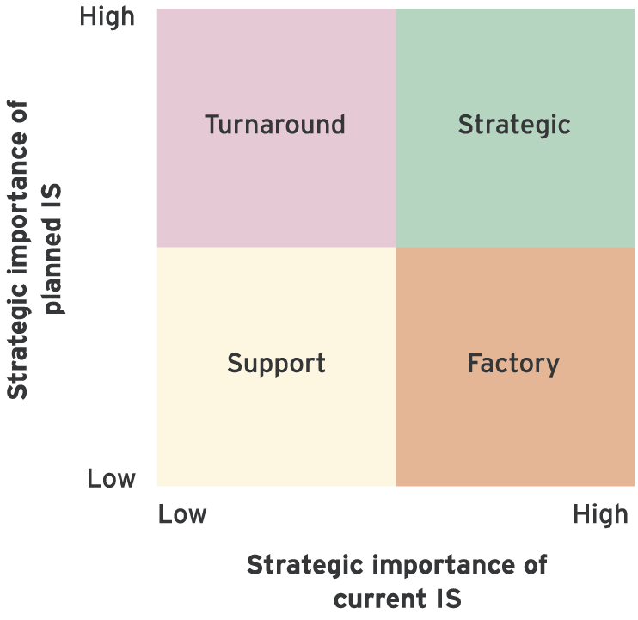
McFarlan’s strategic grid
Source: Cash et al (1992).
Used to indicate the strategic importune of IS to a company now and in the future.
The strategic segment indicates that the business depends on both its existing IS and its continued investment in new IS to sustain competitive advantage.
The turnaround segment – business does not currently derive significant competitive benefits from its current IS, future investment in this area has the potential to positively affect the business’s competitive position.
Factory segment – business depends on its current IS but does not envisage further IS investment having a positive competitive advantage from IS.
Support – business does not and it will not derive significant competitive advantage from IS.

Slide 51
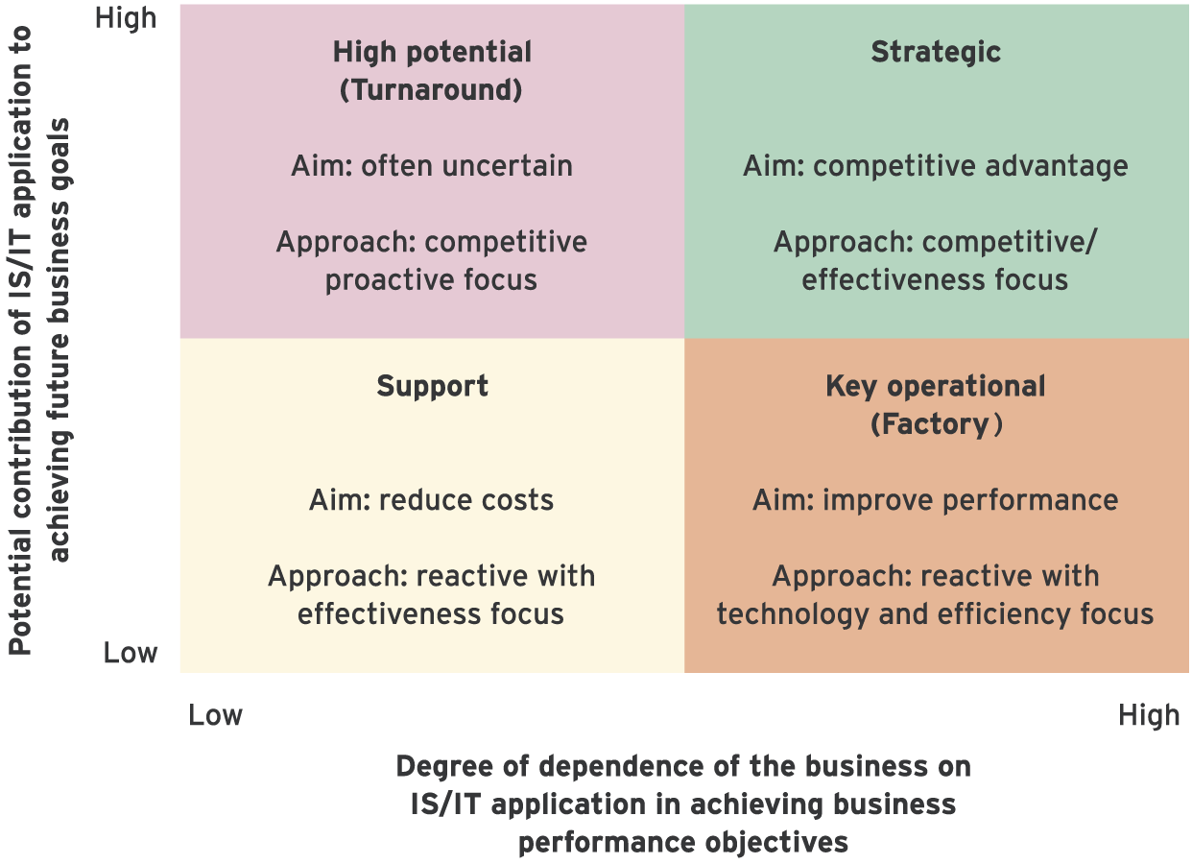
Ward and Peppard’s modified strategic grid
Source: Ward and Peppard (2002).
Support – applications valuable to the organisation but not critical its success
Key operational – mission-critical applications
High potential: applications may be important for the future success of the company
Strategic – applications critical to sustaining future business strategy

Slide 52
Four sectors on strategic grid
Support: These applications are valuable to the organisation but not critical to its success.
Key operational: The organisation currently depends on these applications for success (mission-critical).
High potential: These applications may be important to the future success of the organisation.
Strategic: Applications that are critical to sustaining future business strategy.

Slide 53
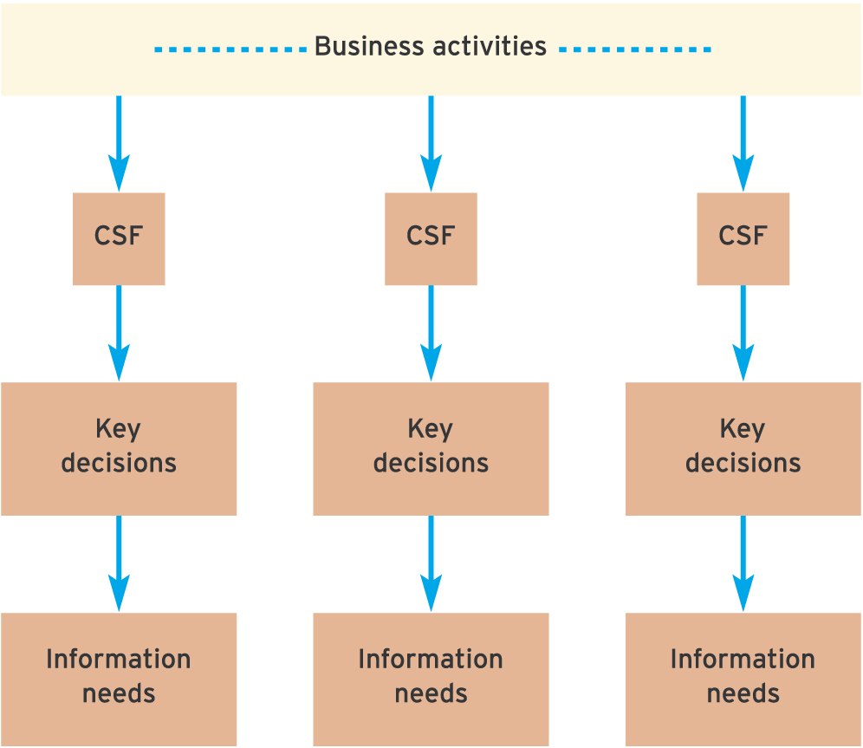
Critical success factors and deriving information needs
CSFs – measures that indicate the performance or efficiency of different parts of an organisation and its processes
CSFs will exits in every functional are of the business
Example: in sales a CFS for an account handler may be accurate and speedy recording and retrieval of sales data.
Once CSFs are identified its is possible to consider te key decisions that have to be made if those CSFs are to be achieved.

Slide 54
IS and Business strategy integration Alignment and impacting strategy
Business-aligning IS strategy: The IS strategy is derived directly from the business strategy in order to support it. IS strategy will be generated from the business strategy through techniques such as CSF analysis.
Business-impacting IS strategy: The IS strategy is used to favourably impact the business strategy, perhaps by introducing new technologies. This could be achieved by the used of value chain analysis. Try to identify strategic IS opportunities within and between value chain elements.

Slide 55
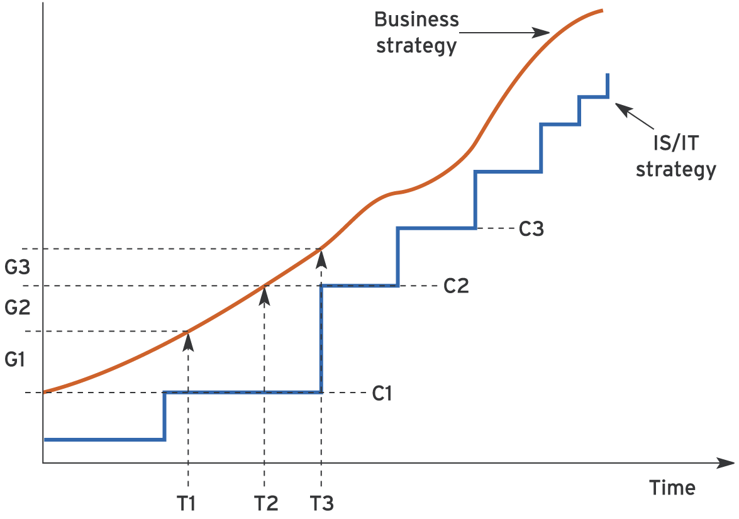
IS/IT capability/requirement model showing a strategic mismatch between IS/IT capability and business requirements

Slide 56
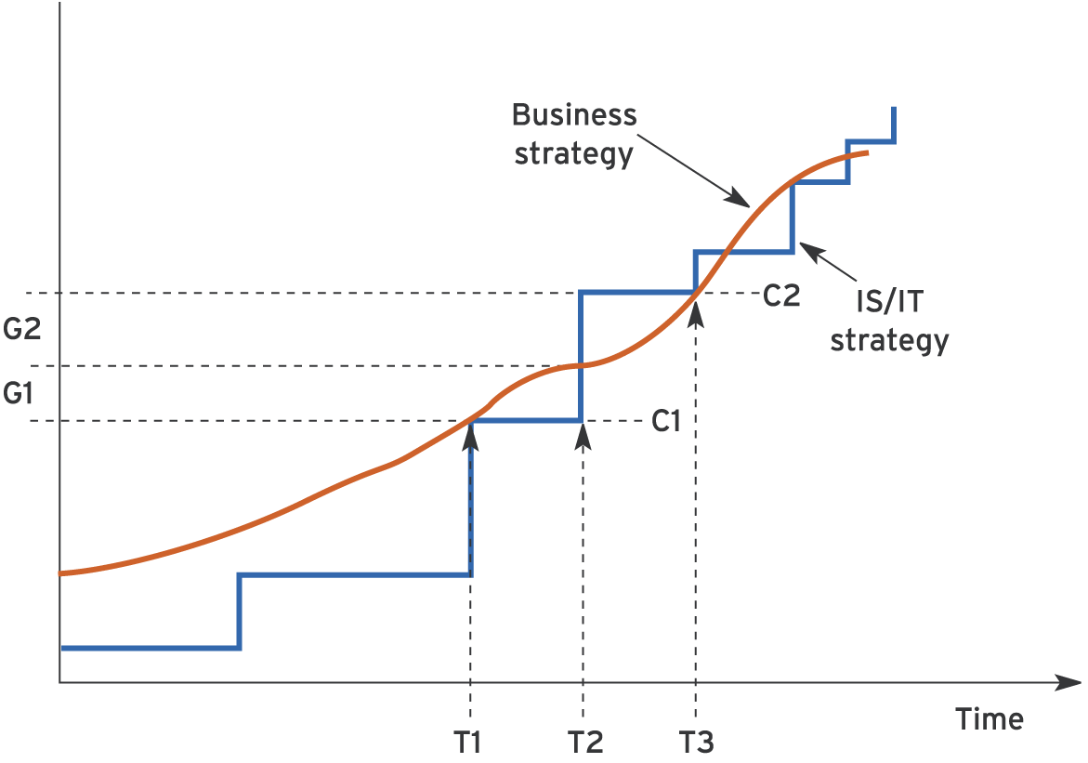
IS/IT capability/requirement scenario 2 showing a strategic mismatch between IS/IT capability and business requirements

Slide 57
Summary
The strategic context of IS
Strategy process models
Tools for strategic analysis and definition
CRM
Business value of using Internet technologies to become an agile competitor or to form a virtual company
Use of Knowledge management systems for gaining strategic advantages

Slide 58
References
Johnson and Scholes (1999) Exploring Corporate Strategy, Prentice Hall Europe, Hemel Hemstead
Bocij, Chaffey, Greasley & Hickie (2006) Business Information Systems, Prentice Hall – Chapter 14
O’Brien, Markas, 2007, Management Information Systems, Chapter 2,

Slide 59


